Slide 1

Big Data Analytics on Netflix Dataset
Using Hadoop Ecosystem
Nayab Khalid (SP23-BDS-039)
Noor ul huda batool (SP23-BDS-040)
HADOOP
APACHE SPARK
APACHE HIVE
HBASE

Slide 2
Project Overview
This project applies the Hadoop ecosystem to analyze Netflix's large-scale entertainment dataset — extracting user and business insights through distributed processing.
HDFS Ingestion
Spark Processing
Hive Queries
Dataset loaded into distributed HDFS storage
Data cleaning and analytics via PySpark
SQL-style querying on structured data
HBase Storage
Visualization
NoSQL storage for analytics results
Python & Jupyter Notebook dashboards

Slide 3
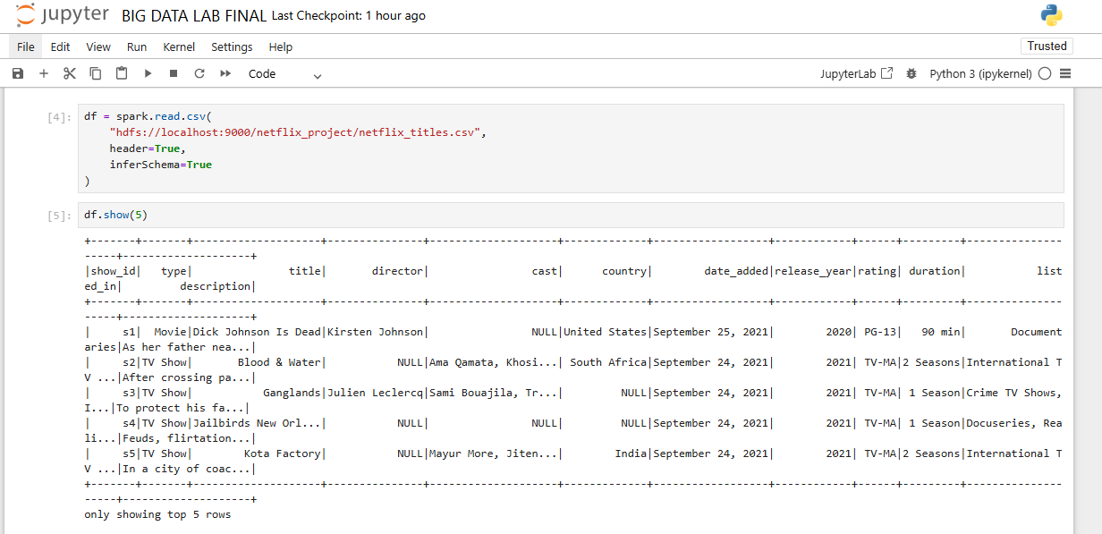
Dataset Description
Netflix Titles CSV
A publicly available dataset cataloging Netflix's content library — spanning movies, TV shows, and original productions across global markets.
Key columns: show_id, type, title, director, cast, country, date_added, release_year, rating, duration, listed_in
~15000 Rows
11 Columns
CSV Format
Content entries
Attributes per record
Comma-separated values

Slide 4
Tools & Technologies
Tool
Purpose
Hadoop HDFS
Distributed file storage
Apache Spark
Data cleaning & analytics
Apache Hive
SQL querying on big data
HBase
NoSQL columnar storage
Jupyter Notebook
Interactive development
Python / PySpark
Data processing & visualization
Raw CSV data flows through the Hadoop ecosystem, from ingestion to distributed processing, querying, and final visualization.

Slide 5
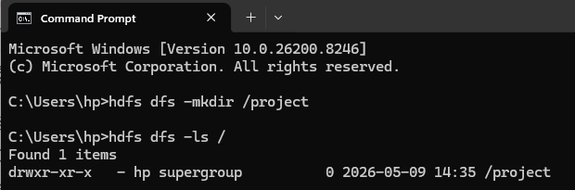
HDFS Data Ingestion
Uploading to HDFS
The Netflix CSV was uploaded to HDFS, enabling fault-tolerant, distributed storage across the cluster.
hdfs dfs -mkdir -p /project/netflix/
hdfs dfs -put netflix_titles.csv /project/netflix/
hdfs dfs -ls /project/netflix/
Distributed
Fault-Tolerant
Scalable
Blocks replicated across nodes
Automatic replication
Handles petabytes of data

Slide 6
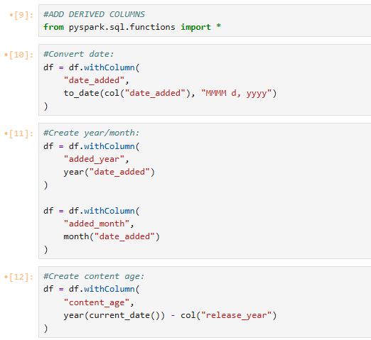
Data Cleaning with Spark
Preprocessing Steps
Removed null and duplicate records
Handled missing director, cast, and country fields
Standardized date formats
Created derived columns for deeper analysis
Derived Fields
content_age
added_year
date_added
Years since release
Release decade grouping
Short / Medium / Long

Slide 7
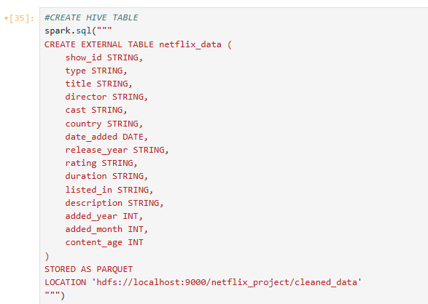
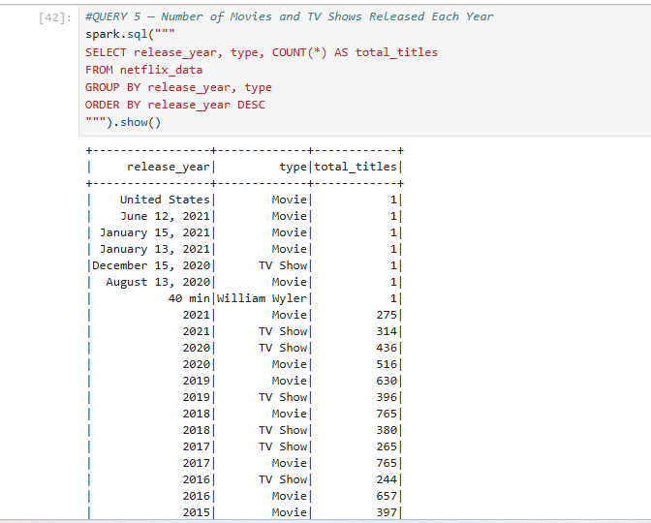
Hive Table Creation & Queries
External Hive Table
An external Hive table was created over the cleaned HDFS dataset, enabling SQL-style analytics at scale.
Sample Queries
SELECT release_year, type, COUNT(*) AS total_titles
FROM netflix_data
GROUP BY release_year, type
ORDER BY release_year DESC

Slide 8
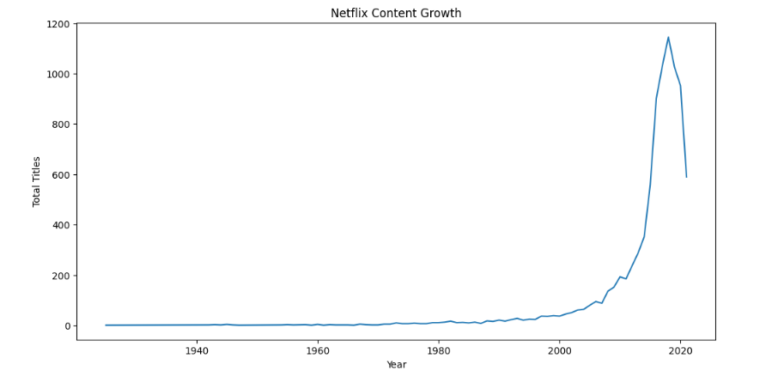
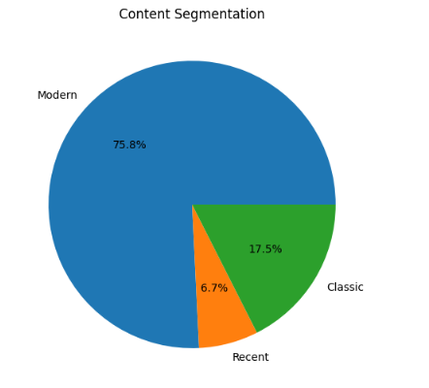
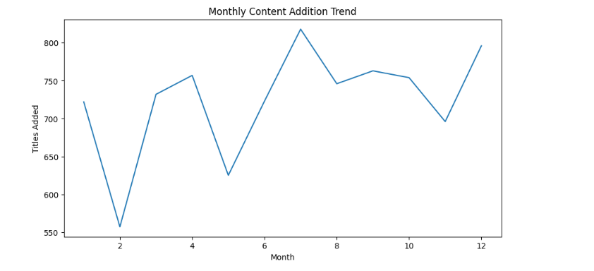
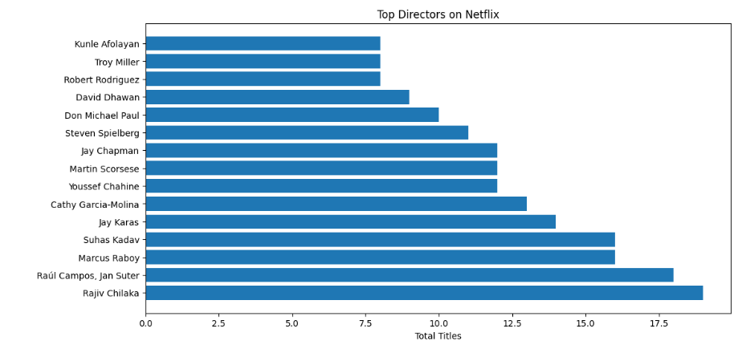
Advanced Spark Analytics
PySpark aggregations revealed key patterns across content type, genre, geography, and release trends.

Slide 9
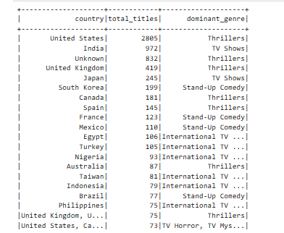
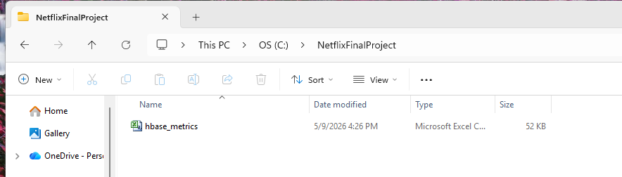
HBase Integration
Storing Results in HBase
Key analytics metrics were persisted in HBase for fast, random-access retrieval — ideal for dashboards and APIs.
SELECT
country,
COUNT(*) AS total_titles,
MAX(listed_in) AS dominant_genre
FROM netflix_data
GROUP BY country
ORDER BY total_titles DESC
Schema Design
Row Key
Column Family
release_year
stats:total_titles
country
stats:dominant_genre

Slide 10

Business Insights
🎬 Movies Dominate
Movies outnumber TV Shows, reflecting Netflix's film-first strategy
📈 Post-2015 Surge
Content production accelerated sharply after 2015 with original investments
🌎 USA Leads
The United States contributes the highest volume of content globally
🎭 Genre Trends
Drama and International Movies dominate; mature ratings are most common

Slide 11

Challenges & Learning Outcomes
Challenges
Learning Outcomes
Hadoop configuration
Spark setup
Handling missing data
HBase integration complexity
Working with Hadoop ecosystem
Distributed data processing
Big data querying

Slide 12
Conclusion
End-to-End Big Data Pipeline
Scalable Data Processing
Built a complete analytics workflow on the Netflix dataset using the Hadoop ecosystem.
Used HDFS for storage, Spark for distributed processing, and Hive for efficient querying.
Actionable Insights
Practical Impact
Uncovered trends in content growth, genres, country-wise production, and audience ratings.
Integrated HBase for fast retrieval and strengthened skills in scalable, real-world analytics.

